Slide 1
















01. DATA STRUCTURE FUNDAMENTALS
Meet the LIST
“An ordered, mutable collection that stores multiple values.”
01CORE IDEA
02LIST ANATOMY
ONE VARIABLE • MULTIPLE VALUES
# Declaration of a heterogeneous list
"Vamshi"
22
"AI"
8.94
A List allows you to group related data items into a single, manageable container object.
01 ORDERED
index 0
index 1
index 2
index 3
Position/indexing is strictly preserved in memory. Insertion sequence remains fixed.
02 MUTABLE
List elements can be modified, added, or removed in-place after creation without changing identity.
SQUARE-BRACKET SYNTAX
SINGLE-ITEM LIST
Does NOT require a trailing comma (unlike tuples).
03 HETEROGENEOUS
"x"
"y"
Different data types (strings, integers, floats, booleans, objects) can freely coexist together.
LIST CONSTRUCTOR FUNCTION
list
1
2
3
# Converts iterable tuple
→ [1, 2, 3]

Slide 2

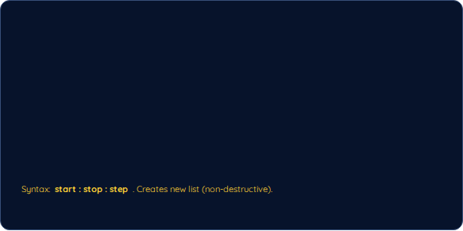










02. SEQUENCE MANIPULATION
Working with LISTS
“Access, modify, slice and combine values inside a mutable sequence.”
01INDEXING
02SLICING
"A"
"B"
"C"
"D"
10
20
30
40
50
0123
10
50
-4-3-2-1
t[1:4] → [20, 30, 40]
t[::-1] → [50, 40, 30, 20, 10] (Reverse)
t[0] → "A" t[-1] → "D"
Positive starts at 0. Negative starts at -1.
03OPERATORS
04ITERATION & MUTATION
Concatenation (+)
[1,2] + [3,4] → [1,2,3,4]
FOR-LOOP TRAVERSAL
MUTATION
t[1] = "X"
Repetition (*)
[1,2] * 2 → [1,2,1,2]
Iterates items sequentially.
["A","B","C"]
Membership (in)
2 in [1,2,3] → True
["A","X","C"]

Slide 3






03. BEHAVIORAL MATRIX & IN-PLACE MODIFICATION
The POWER of a LIST
“Lists are ordered sequences designed to change as your program runs.”
01TECHNICAL CAPABILITIES MATRIX
02LIVE MUTATION TEST
Property / Operation | LIST [ ] Specification
Ordering | Ordered (Sequence preserved)
Mutability | Mutable (Elements editable in-place)
Duplicate Values | Allowed (e.g. [1, 1, 2])
Indexing | Supported — O(1) time complexity
Slicing | Supported — Returns new sublist
Adding Elements | append(), insert(), extend()
Removing Elements | remove(), pop(), clear()
Replacing Elements | numbers[0] = 100
10
20
30
numbers[0] = 100
numbers.append(40)
numbers.pop()
TAKEAWAY: Use a LIST when data needs to change, grow, shrink, or be reordered dynamically during execution.

Slide 4














04. ADVANCED CONCEPTS & PRACTICAL APPLICATIONS
Beyond the BASICS
“Methods, nested lists, copying, comprehensions and practical use cases.”
01LIST METHODS (MODIFIERS)
02REFERENCE vs SHALLOW COPY
append(x)
extend(iterable)
REFERENCE (ALIASING)
SHALLOW COPY
adds 1 item to end
appends multiple items
# a → [1, 2, 3, 4]
1
2
3
4
1
2
3
insert(i, x)
remove(x)
4
# a → [1, 2, 3]
inserts at position i
removes 1st matching value
pop()
clear()
03LIST COMPREHENSION
removes & returns item
removes all items
sort()
reverse()
for
in
range
1
5
→ [1, 4, 9, 16]
sorts list in place
reverses list in place
DISTINCT BUILT-IN FUNCTIONS:
len(L)
min(L)
max(L)
sum(L)
Provides a clean, elegant syntax for generating filtered/transformed lists.
04WHEN TO CHOOSE LISTS
UNPACKING
NESTED LISTS
"Vamshi"
22
"AI"
"A"
90
"B"
85
0
1
→ 90
LIST [ ] | TUPLE ( )
Dynamic, growing collections | Fixed size records / coordinates
Frequent insertions/removals | Read-only / Multiple return values
Lists can contain nested sublists or other structures.
Groups multiple values and unpacks into distinct variables.
CONVERSION:
list(t) ↔ tuple(L)

